Slide 1
Mental Health Tracker
Presented By,
Rifat Bin Alam
ID: 23103250
Course: Database Management System Lab (CSC434)
Section: I

Slide 2
Contents
ER Diagram
Database Schema
Feature showcase

Slide 3
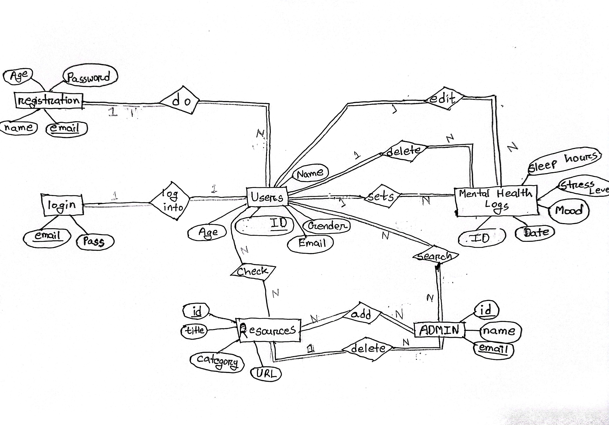
ER Diagram

Slide 4
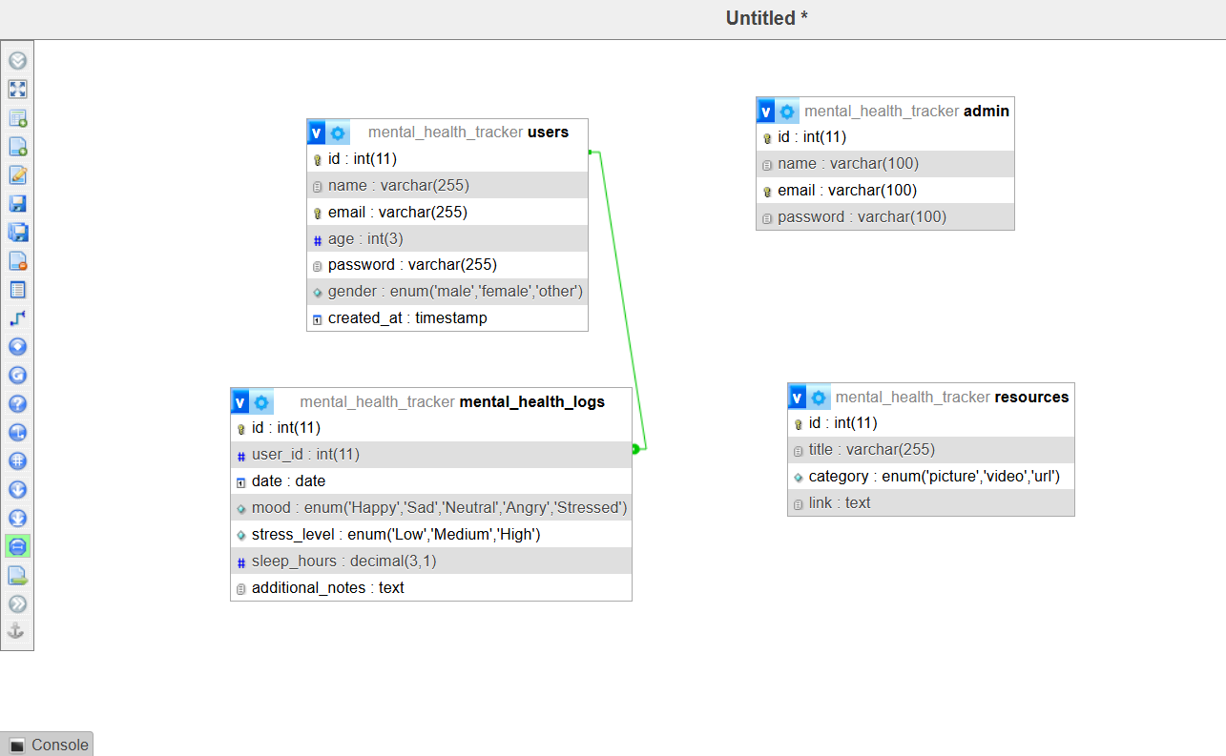
Database Schema

Slide 5
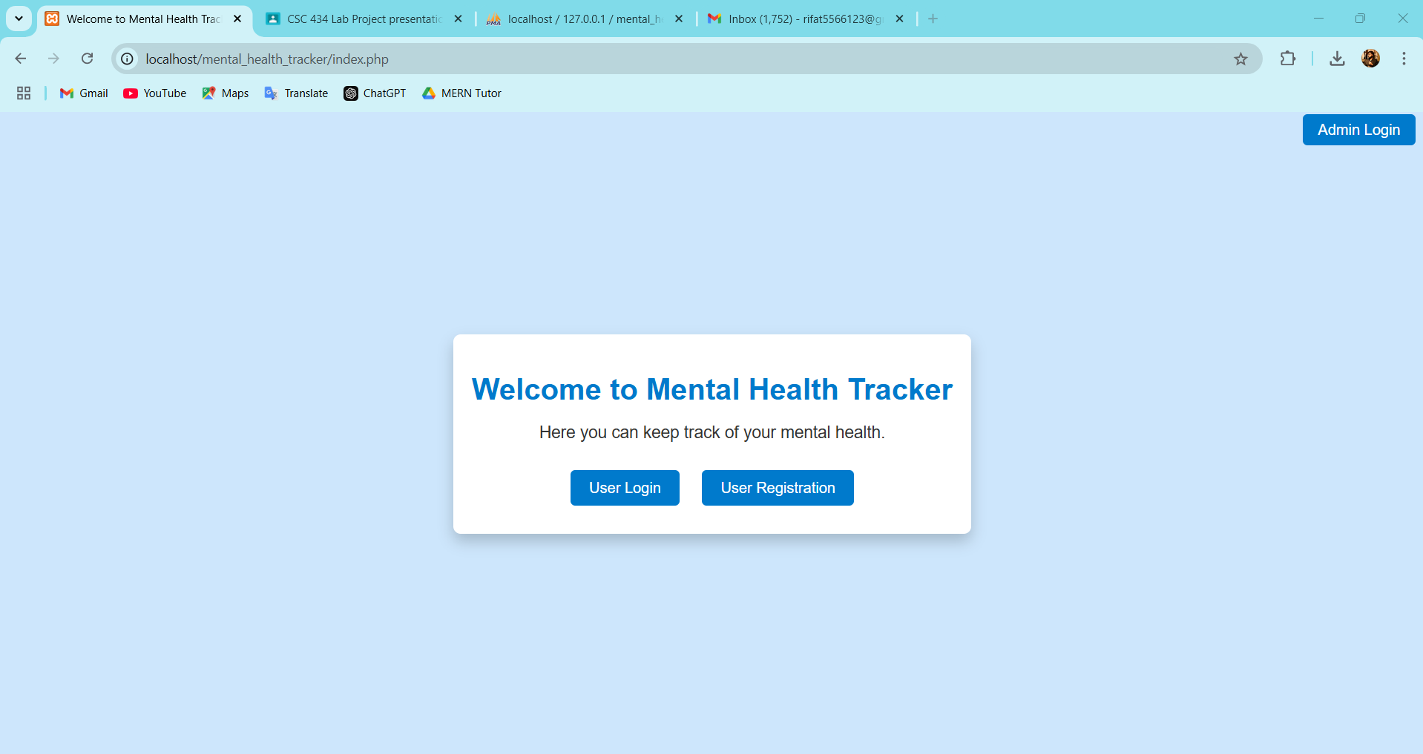
Feature showcase:

Slide 6
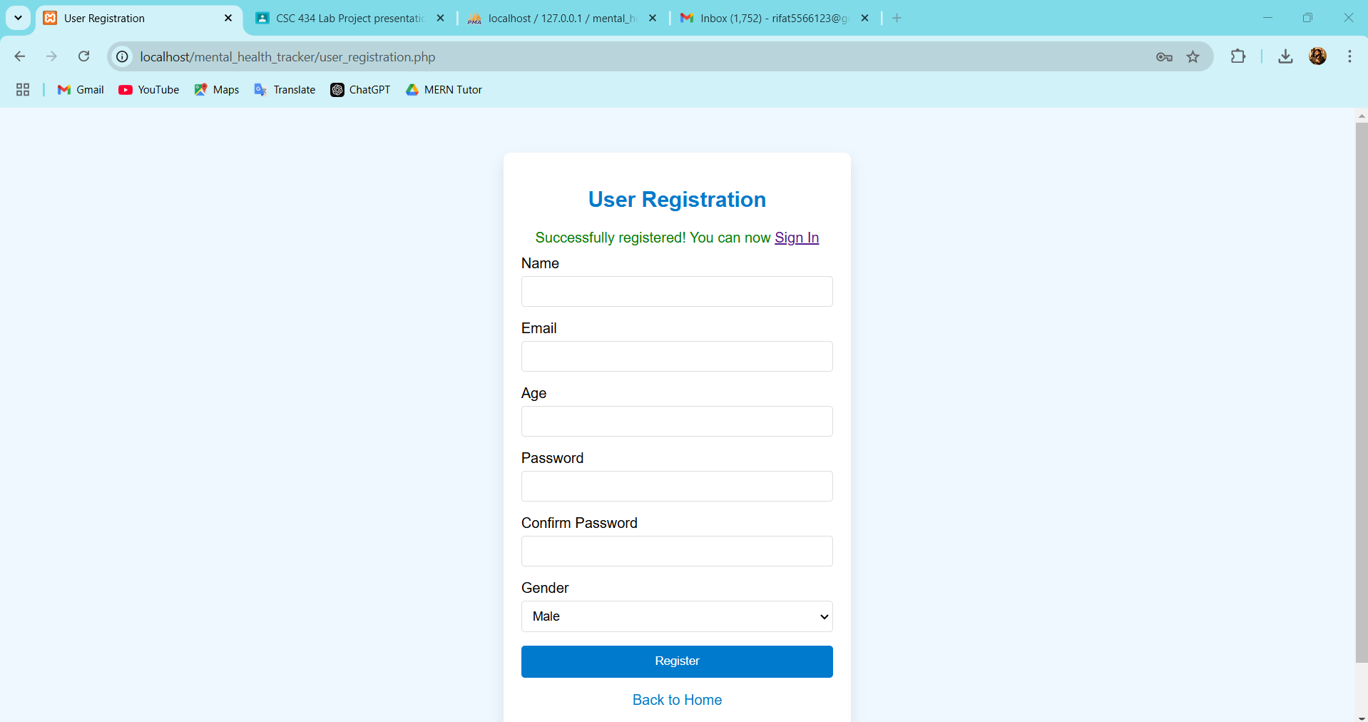
Registration Feature:

Slide 7
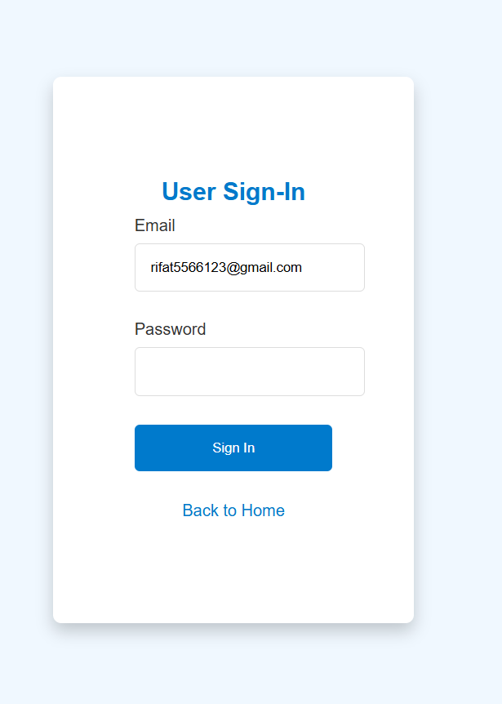
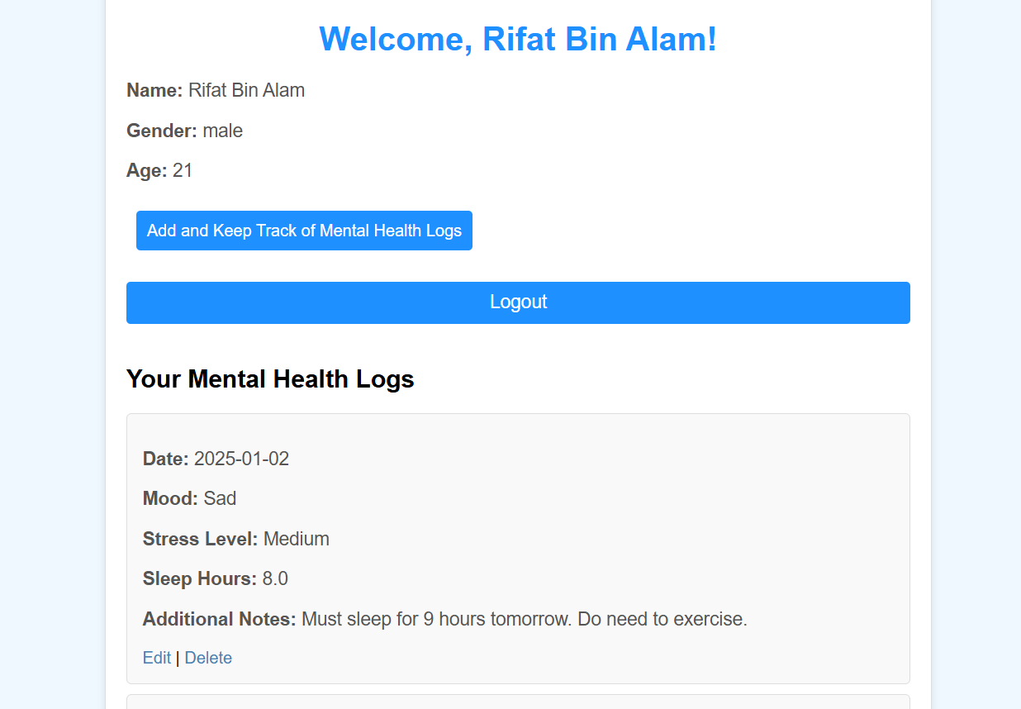
User Login then Dashboard

Slide 8
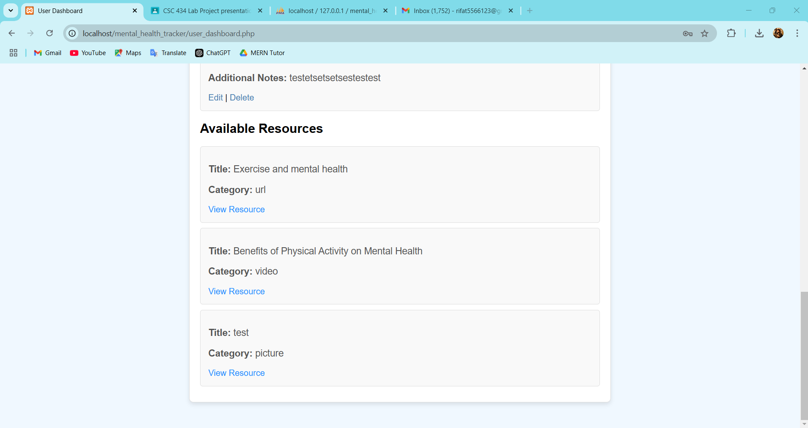
User Login then Dashboard contd…

Slide 9
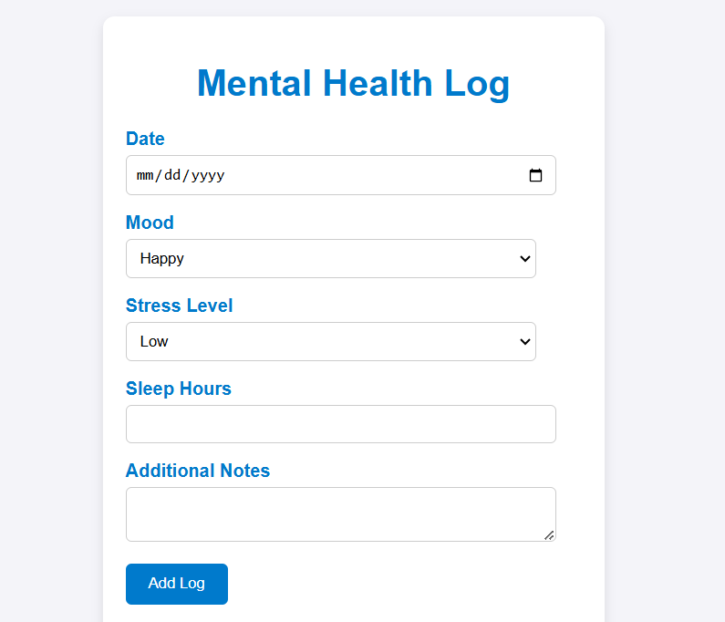
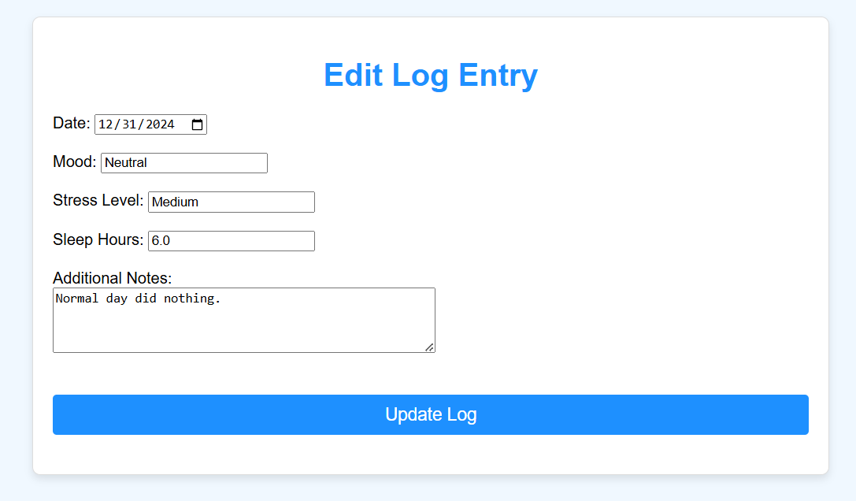
Add or Edit Mental Health Log

Slide 10
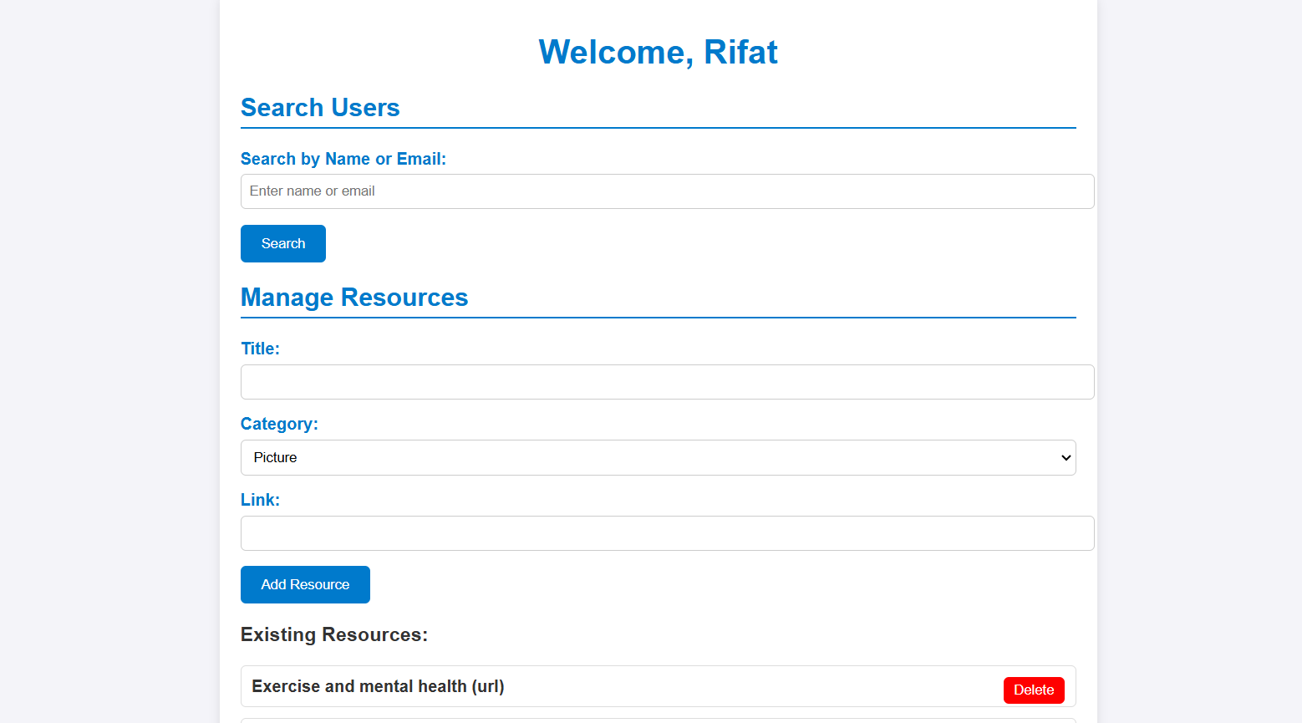
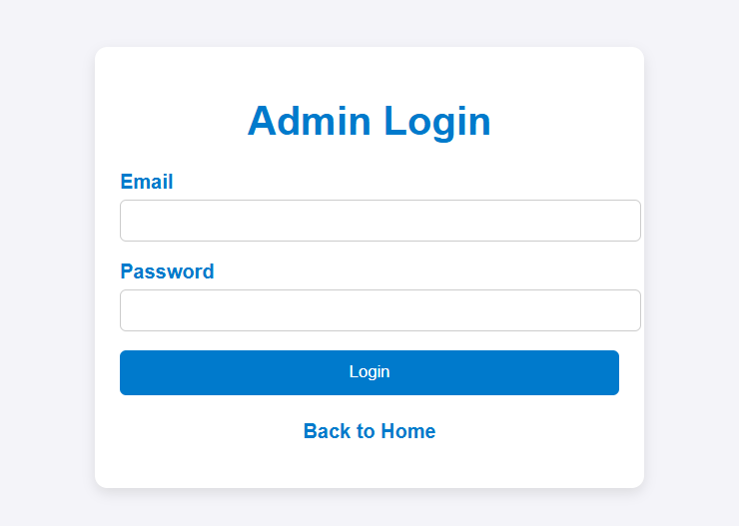
Admin Login and dashboard

Slide 11
Thank You Everyone For Your Kind Attention

